Slide 1
Oracle 10g Database Administrator: Implementation and Administration
Chapter 2
Tools and Architecture

Slide 2
Objectives
Identify the main DBA tools in the Oracle10g software suite
Configure Oracle Net Services to connect to the database
Examine Oracle database instance architecture
Examine Oracle database memory architecture

Slide 3
Objectives (continued)
Examine Oracle database process architecture
Examine Oracle database connection management architecture
Start using the Enterprise Manager
Go through a brief introduction to the Database Control

Slide 4
Overview of DBA Tools
Many of these tools become integrated in:
Central workspace
Enterprise Manager console
Database Control
Grid Control
Tools give you a way to work on the database
In a Windows-style environment
You must also understand how to work directly from the command line

Slide 5
Overview of DBA Tools (continued)

Slide 6
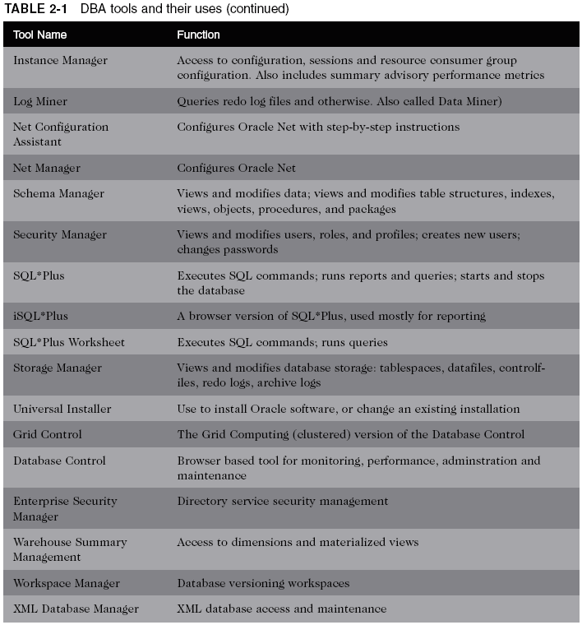
Overview of DBA Tools (continued)

Slide 7
Overview of DBA Tools (continued)
Changing a user’s password
Using a command-line tool
See Figure 2-1
Using Security Manager
See Figure 2-2
Some tasks can be handled by more than one tool
Oracle Net Services is a common denominator for these tools

Slide 8
Overview of DBA Tools (continued)

Slide 9
Overview of DBA Tools (continued)

Slide 10
Overview of DBA Tools (continued)

Slide 11
Configuring Oracle Net Services to Connect to the Database
Nearly every time you access Oracle10g
You go through Oracle Net Services

Slide 12
Overview of Oracle Net Service Architecture
Oracle Net Services
Made up of several subcomponents that work together
Client and server installations of Oracle Net Services
Must be configured to be synchronized to the target database
Configuration is stored in the tnsnames.ora
Service name
Set of information used to locate and communicate with an Oracle database

Slide 13
Overview of Oracle Net Service Architecture (continued)

Slide 14
Overview of Oracle Net Service Architecture (continued)
Client side can reach the server-side database
By using the service name
Combined with a valid user name and password
Bequeath protocol
Allows a direct connection to a database
On a database server computer
Without going through Oracle Net services
Without requiring a network name
Allowed only when you are logged on to the database machine

Slide 15
Overview of Oracle Net Service Architecture (continued)

Slide 16
Overview of Oracle Net Service Architecture (continued)
Path of communication
Client with Oracle Net
Client with JDBC driver
Terminal with direct connection
Network naming methods
Local naming
Directory naming
Host naming
External naming
Easy connect

Slide 17
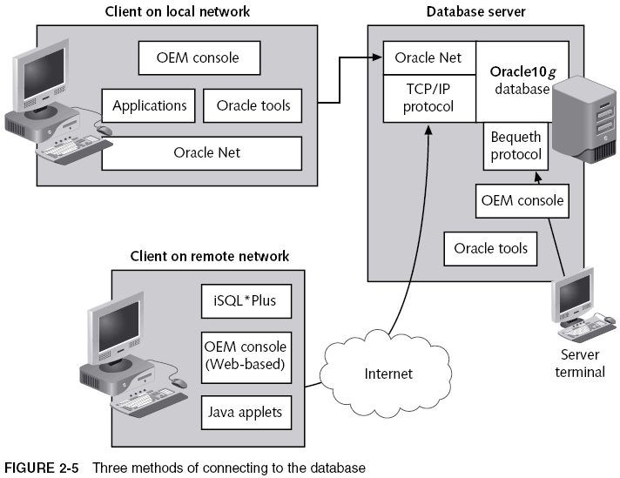
Overview of Oracle Net Service Architecture (continued)

Slide 18
Step-By-Step Configuration of Oracle Net Services Using Net Manager
Steps:
Start Net Manager in Windows
Expand the Local node
Expand the Service Naming node
Highlight Service Naming, and click the big green plus sign

Slide 19
Step-By-Step Configuration of Oracle Net Services Using Net Manager (continued)

Slide 20
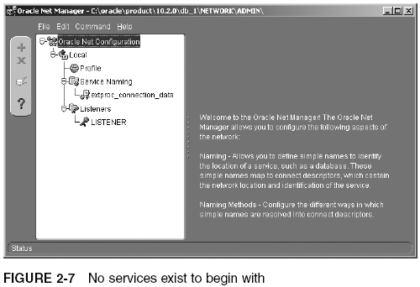
Step-By-Step Configuration of Oracle Net Services Using Net Manager (continued)

Slide 21
Step-By-Step Configuration of Oracle Net Services Using Net Manager (continued)

Slide 22
Step-By-Step Configuration of Oracle Net Services Using Net Manager (continued)
Steps (continued):
For the connection, select TCP/IP (Internet Protocol) as the protocol
Type the computer name on which the database resides in the Host Name box
Accept the default selection of Oracle8i or later

Slide 23
Step-By-Step Configuration of Oracle Net Services Using Net Manager (continued)

Slide 24
Step-By-Step Configuration of Oracle Net Services Using Net Manager (continued)

Slide 25
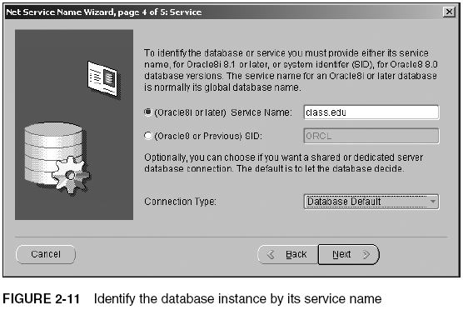
Step-By-Step Configuration of Oracle Net Services Using Net Manager (continued)

Slide 26
Step-By-Step Configuration of Oracle Net Services Using Net Manager (continued)
Steps (continued):
Click Test
Click Close to close the test window
Click Finish to complete the definition
Save the configuration
By selecting File/Save Network Configuration from the menu
Close Net Manager

Slide 27
Step-By-Step Configuration of Oracle Net Services Using Net Manager (continued)

Slide 28
Step-By-Step Configuration of Oracle Net Services Using Net Manager (continued)

Slide 29
Step-By-Step Configuration of Oracle Net Services Using Net Manager (continued)
ORACLE_HOME and ORACLE_BASE variables
Represent registry entries in Windows
And $<named> variables in Unix or Linux
ORACLE_HOME variable
Refers to the directory where Oracle installs its executable files
ORACLE_BASE variable
The directory upward from the ORACLE_HOME variable

Slide 30
TNS Configuration Files
The listener.ora file
Stored on the database server
Provides configuration for how the listener process listens over the network, for connection requests
Stored in $ORACLE_HOME/network/admin
The tnsnames.ora file
Placed onto the client machine
Allows communication between client machine and listener on the database sever

Slide 31
Working with the Listener
Listener listens for requests made by user connections
Process then allocates a server process
Start or stop the listener
Windows
Go to the Services window
Use the listener control utility (lsnrctl)
Listener features include:
Change queue size
Set listener logging and tracing

Slide 32
Working with the Listener (continued)

Slide 33
Working with the Listener (continued)
Creating multiple listeners

Slide 34
Working with the Listener (continued)
Loading balance between multiple listeners
You cannot use Net Manager to start and stop the listener

Slide 35
Using the Net Configuration Assistant

Slide 36
Using SQL*Plus, SQL*Plus Worksheet, and iSQL*Plus
Troubleshooting SQL *Plus
Configuration of the listener on the server is incorrect
Client configuration of the tnsnames.ora file is incorrect
Validate configuration using tnsping
Execute SQL *Plus
Select Start/All Programs/Oracle .../Application Development/SQL Plus from the menu
Execute SQL *Plus Worksheet
Select Start/Programs/Oracle/Application Development/SQLPlus Worksheet from the menu

Slide 37
Using SQL*Plus, SQL*Plus Worksheet, and iSQL*Plus (continued)

Slide 38
Using SQL*Plus, SQL*Plus Worksheet, and iSQL*Plus (continued)

Slide 39
Using SQL*Plus, SQL*Plus Worksheet, and iSQL*Plus (continued)

Slide 40
Using SQL*Plus, SQL*Plus Worksheet, and iSQL*Plus (continued)
iSQL *Plus (Internet SQL *Plus)
Web-based version of SQL*Plus
Allows you to write queries and other SQL commands across a network
Returning results in a Web browser
Application server is an HTTP Web server
iSQL*Plus output looks like an HTML table

Slide 41
Using SQL*Plus, SQL*Plus Worksheet, and iSQL*Plus (continued)

Slide 42
Using SQL*Plus, SQL*Plus Worksheet, and iSQL*Plus (continued)

Slide 43
Oracle Instance Architecture
Database instance
Runs on a database server and uses data inside the database
Oracle instance
Part of an Oracle database executing in memory
Made up of processes and memory structures

Slide 44
Shared and Dedicated Server Processes
After a request to connect to the database is received
Oracle creates a user session
Then, Oracle creates a server process
Dedicated server
Every user session has its own server process
Shared server
Uses CPU and memory more efficiently
By swapping out user sessions during idle time

Slide 45
Shared and Dedicated Server Processes (continued)

Slide 46
Shared and Dedicated Server Processes (continued)

Slide 47
Shared and Dedicated Server Processes (continued)
Connection
Link from the user session, through the server session, and to the database instance
Controlled in the client-side configuration of Oracle Net Services
In the tnsnames.ora file

Slide 48
Background Processes
Support and monitor the server processes
Handle database management tasks
To keep the database running efficiently
To help maintain fast performance

Slide 49
Background Processes (continued)

Slide 50
Memory Components
Two main sections of memory
System Global Area (SGA)
Allocated when an instance is started
Deallocated when the instance is shut down
Program Global Area (PGA)
Effectively used in session connection memory
Broken into private chunks for each server process

Slide 51
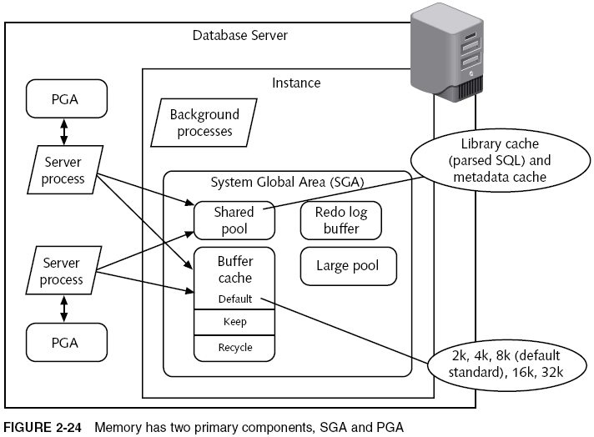
Memory Components (continued)

Slide 52
Introducing Enterprise Manager
In previous versions of Oracle
Executing the Enterprise Manager console was complicated
Too much power was placed into the console software
Oracle10g divides power
Between the console and the Database Control

Slide 53
Running the Enterprise Manager Console
Steps:
Click Start/All Programs/Oracle .../Enterprise Manager Console
Add connections to databases
Add new database service to the console
In the main window of Enterprise Manager console, double-click the Databases folder
Click the Navigator menu, and then click Add Database to Tree
Add selected DBs from your local tnsnames.ora file

Slide 54
Running the Enterprise Manager Console (continued)

Slide 55
Running the Enterprise Manager Console (continued)

Slide 56
Running the Enterprise Manager Console (continued)
Steps (continued):
Expand the ORACLASS database node
Log on to the database as SYSTEM

Slide 57
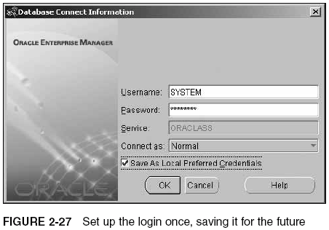
Running the Enterprise Manager Console (continued)

Slide 58
Viewing the Features of Enterprise Manager
Four primary tools
Instance Manager
Monitors activities in the database
Schema Manager
Displays table structures, creates new tables, indexes, views, and any other type of object
Security Manager
Creates new users, allocates storage resources to users, and changes passwords
Storage Manager
Monitors storage use

Slide 59
Viewing the Features of Enterprise Manager (continued)
Examine Instance Manager
Double-click the Instance icon
Click the Configuration icon
Click the All Initialization Parameters button
Select audit_trail, and then click Description
Click the Category column heading
Click the Cancel button to return to the main console window
Double-click Sessions
Click SYSTEM under Sessions
Collapse the Instance Manager node

Slide 60
Viewing the Features of Enterprise Manager (continued)

Slide 61
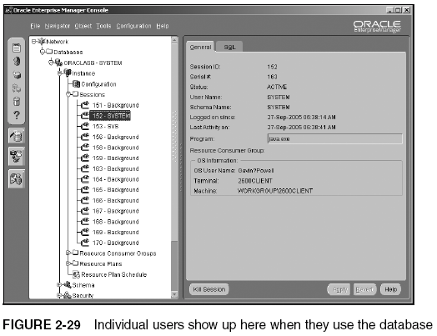
Viewing the Features of Enterprise Manager (continued)

Slide 62
Viewing the Features of Enterprise Manager (continued)
Examine Schema Manager
Double-click the Schema icon in the console
Scroll down in the left window and double-click the SYSTEM schema
Double-click the Tables folder
Scroll down and double-click the HELP table
Click the Indexes folder below the HELP table in the left side of the console
Right-click the HELP table
Select Show Object DDL from the pop-up menu
Click Close to return to the main console window

Slide 63
Viewing the Features of Enterprise Manager (continued)

Slide 64
Viewing the Features of Enterprise Manager (continued)

Slide 65
Viewing the Features of Enterprise Manager (continued)

Slide 66
Viewing the Features of Enterprise Manager (continued)
Examine Schema Manager (continued)
Scroll down and right-click the Views folder
Select Save List in the pop-up window
Click Cancel to return to the console window

Slide 67
Viewing the Features of Enterprise Manager (continued)

Slide 68
Viewing the Features of Enterprise Manager (continued)
Examine Security Manager
In the console, double-click the Security icon
Double-click the Users folder
Scroll down and select the SYSTEM user
Double-click the Roles folder
Scroll down on the left side of the console and select the RESOURCE role
Click the System tab

Slide 69
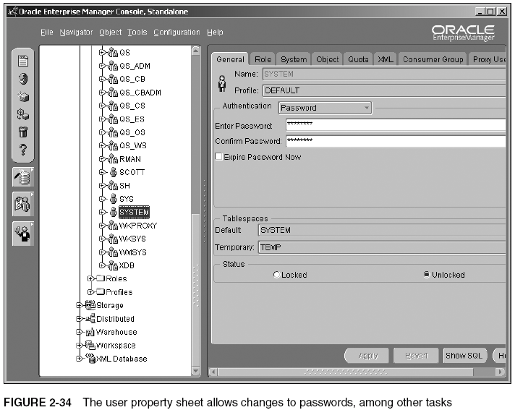
Viewing the Features of Enterprise Manager (continued)

Slide 70
Viewing the Features of Enterprise Manager (continued)

Slide 71
Viewing the Features of Enterprise Manager (continued)
Examine Storage Manager
Double-click the Storage icon on the left side of the console
Select Tablespaces under the Storage icon
Double-click the Datafiles folder
Click the datafile with the name TEMP01.DBF
Click the Storage tab
Close the console by clicking the X in the top-right corner of the window

Slide 72
Viewing the Features of Enterprise Manager (continued)

Slide 73
Viewing the Features of Enterprise Manager (continued)

Slide 74
The Database Control Interface
Get the Database Control up and running
By typing this URL into a browser:
http://2600client:1158/em
Tabs
Home
Provides general information about the database and the Oracle installation

Slide 75
Viewing the Features of Enterprise Manager (continued)

Slide 76
Viewing the Features of Enterprise Manager (continued)

Slide 77
The Database Control Interface (continued)
Tabs (continued)
Performance
Shows performance information, both good and bad

Slide 78
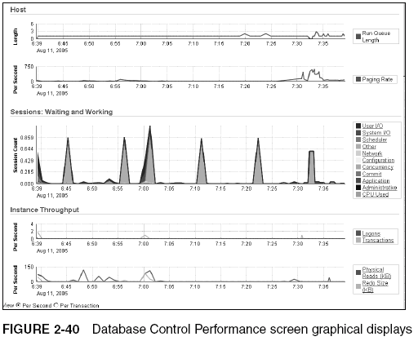
Viewing the Features of Enterprise Manager (continued)

Slide 79
Viewing the Features of Enterprise Manager (continued)

Slide 80
The Database Control Interface (continued)
Tabs (continued)
Administration
Provides a multitude of options for administration functionality
Maintenance
Provides comprehensive maintenance access to:
Database utilities
Backup/recovery
Deployment activities

Slide 81
Viewing the Features of Enterprise Manager (continued)

Slide 82
Viewing the Features of Enterprise Manager (continued)

Slide 83
Summary
Using command-line interfaces to manually execute commands may be necessary
Oracle Net Services
Allows communication between a tool and database
Must be configured on both the client and the server
The Listener Oracle service waits to receive requests sent to the database
Service name defines the DB’s name, location, and listening port
Use Net Manager and the Net Configuration Assistant to configure Oracle Net Services

Slide 84
Summary (continued)
Net Manager guides you through the steps of configuring a new service name
File tnsnames.ora stores Oracle Net Services configuration settings on the client side
File listener.ora stores Oracle Net Services configuration settings on the server side
Server process reads data from datafiles and places it in the buffer cache
Dedicated server
Shared server

Slide 85
Summary (continued)
PGA stores shared connection memory allocations, separately for each application
Managers
Instance Manager tracks database activity
Set the user and password as preferred credentials
Schema Manager provides details on schema objects
Security Manager is focused on users and privileges
Roles group privileges into related sets
Storage Manager displays information about datafiles and tablespaces

